Slide 1
Integration of Fanno and Rayleigh flow

Slide 2
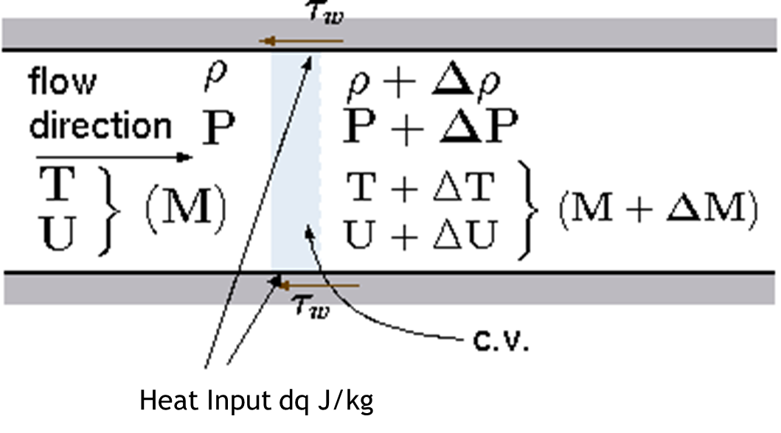
Assumptions :
1-D compressible flow
Steady state
Inviscid flow
Constant area duct
Fuel mass neglected
Heat input dq/dx = constant
Perfect gas
Constant specific heats
Constant friction coefficient

Slide 3





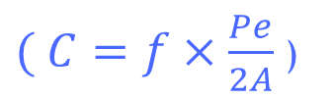
1. Momentum Equation :
2. Heat Supply Rate :
$( C=f×\frac{Pe}{2A}$ )
3. Substitute ‘q’ in equation 1 :
4 . Rearranging equation 3 :
( B $=C/K$ )

Slide 4




5. Continuity Equation :
6. State Equation :
7. Using equations 4,5 and 6 :
8. Energy equation :

Slide 5




9. Substitute equation 7 in 8 :
10. Mach number :
11. Stagnation Temperature :
(To = T X)
12. Using equation 10 and 11 :

Slide 6

Final Equation :
(Using 9 and 12 )

Slide 7
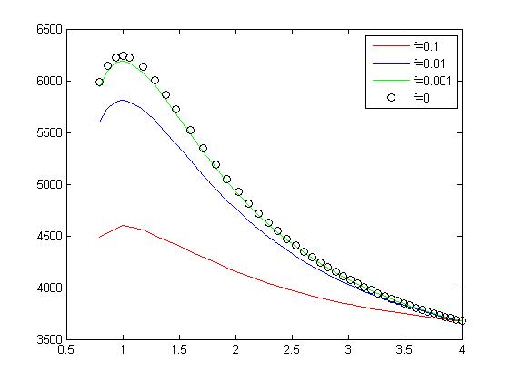
On solving the equation numerically :
Sample conditions :
M4 = 4
T04 = 3676
P4 = 104*10^3
γ =1.4
R =287
p/a =4/0.05
K =20*10^6 J/kg/m
T stagnation
Mach no

Slide 8
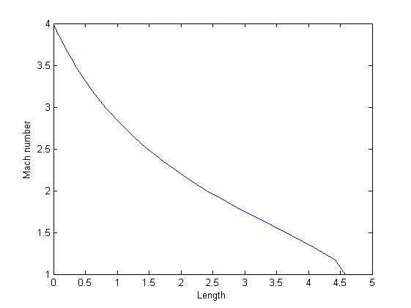
Variation of properties with length

Slide 9
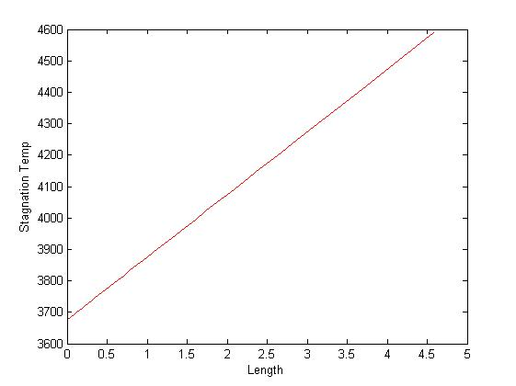
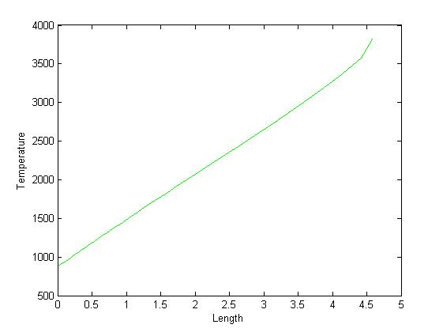
Variation of properties with length

Slide 10
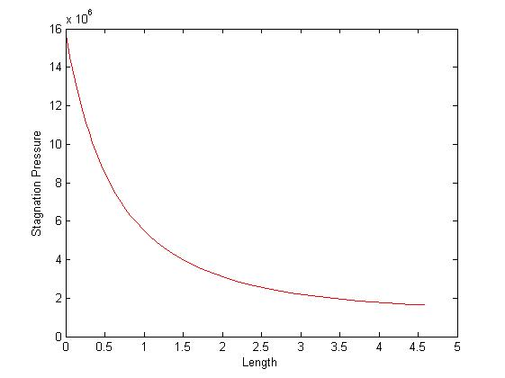
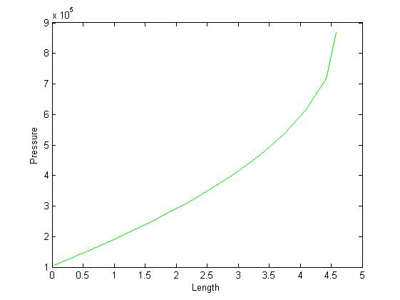
Variation of properties with length

Slide 11
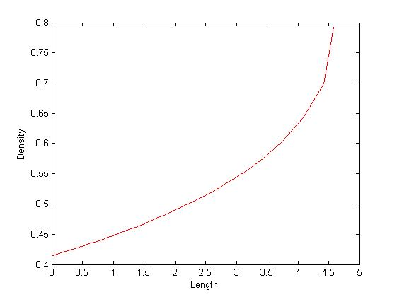
Variation of properties with length

Slide 12
Thank you

